Slide 1
PAEDIATRIC NURSING
Mr. Simiyu

Slide 2
COURSE OBJECTIVES
It is expected that at the end of this course students will be able to do the following;
Define paediatric nursing
Describe the principles of paediatric nursing
Recall normal growth and development of child
Describe the effects of illness and hospitalization in a child
Describe childhood illness/conditions:
Manage childhood illnesses using IMCI guidelines

Slide 3
PAEDIATRIC NURSING
Paediatric nursing is defined as the art and science that deals with management of childhood related disorders/diseases.
Paediatric nursing is concerned with the health of infants, children and adolescents, their growth and development and their opportunity to achieve full potential as adults.

Slide 4
Components of pediatric nursing
The nursing care of children from birth through adolescence includes;
health promotion,
disease prevention,
illness management, and
health restoration

Slide 5
Age group
Child health is based on promotion of health/healthful living of a well child
Internationally, the upper age limit of a child is 21 years. In Kenya, it is 12 years.
A neonate is a newborn from birth to 28 days of age

Slide 6
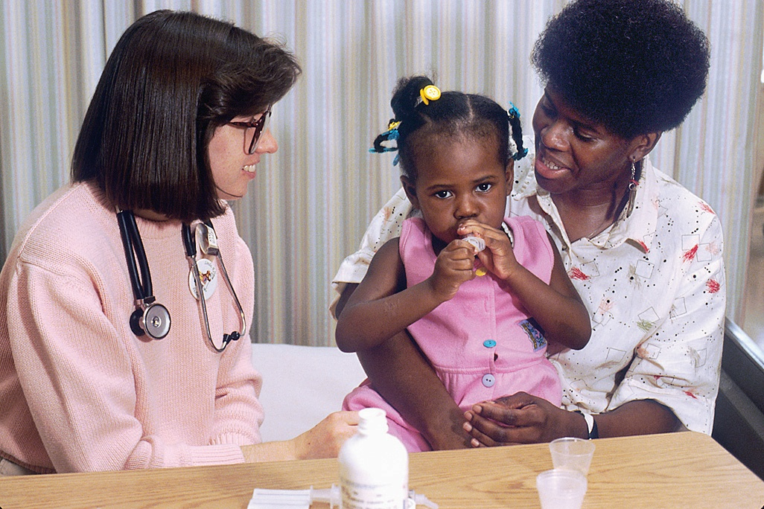

Slide 7
Nursing process in pediatric nursing
The care of children and their families requires the application of the nursing process in accordance with accepted standards of practice, professional performance, and ethics.

Slide 8
Quality pediatric care
Quality pediatric care is:
Developmentally appropriate,
Family centered,
Culturally sensitive, and
Evidence-based.

Slide 9
Additional hallmarks of quality care
Compassion,
advocacy,
care coordination,
continuity of care, and
a holistic approach
These themes provide the context for standards that direct the practice of pediatric nurses.

Slide 10
ROLE OF THE PEDIATRIC NURSE
Therapeutic relationship role
Family care role
Advocacy role
Disease prevention/Health promotion role
Supportive / counseling role
Restorative role

Slide 11
1. Therapeutic relationship Role
This by relating to children and their families and able to distinguish their feelings and needs.

Slide 12
2. Family advocacy/caring
Nurse work with family members, identify their goals and needs and plan interventions that meet the defined problems.

Slide 13
3. As an advocate
The nurse assists children and their families in making informed choices and acting in the child best interest.

Slide 14
4.Disease prevention/Health promotion
Disease prevention/Health - Nurses involved with caring for children must practice preventive health. Example is safety .

Slide 15
4. Support/ counselling
Attention to emotional needs requires support and sometimes counselling.

Slide 16
5. Restorative role
This involves meeting the physical and emotional needs of children including feeding, bathing, toileting, dressing , security and socialization

Slide 17
OTHER ROLES
Health education
Psychologic support and counselling
Coordination and collaboration
Researcher
Health care planning

Slide 18
MODELS OF CARE IN PEDIATRIC NURSING
Family-centered care
Relationship-based care
These are two models of care used in the delivery of nursing care to children.
In both models, the importance of the family to the child is emphasized.
In both, the unit of care is the child and the caregiver(s).

Slide 19
FAMILY-CENTERED CARE MODEL
Core concepts of family-centered care include the following:
Dignity and respect for the child and family
Information sharing with the family
Participation in care by the family
Collaboration with the family to plan and provide care

Slide 20
Relationship-based care
Core concepts of relationship-based care include the following:
The child and family remain the focal point in the plan of care.
The nurse makes an effort to develop a relationship with the child’s family members and provides one-to-one time for conversations with the child and family on each shift.

Slide 21
Relationship-based care
Care is individualized to meet the specific needs of the child, based on issues that arise in the one-to one conversations with the child and family.
All staff members strive to respect, understand, and address the child’s and family’s concerns.

Slide 22
Relationship-based care
-Children and families are actively engaged in all aspects of care, including decision making.
Open communication must occur between child, family, and staff.
The child’s well-being and dignity must be safeguarded in all aspects of communication and care.

Slide 23
TRENDS IN PEDIATRIC NURSING PRACTICE
Increased numbers of children requiring mental health services
Increased numbers of children becoming ill as a result of antibiotic-resistant organisms
Increased usage of blood conservation techniques for hospitalized children

Slide 24
TRENDS IN PEDIATRIC NURSING PRACTICE
Increased admissions due to:
Environmental risk factors, such as dangerous living environments, unstable households, and risky behaviors
Deficient knowledge base of caregivers, such as not following or understanding the treatment regimen
Lack of primary care access

Slide 25
TRENDS IN PEDIATRIC NURSING PRACTICE
Increased emphasis on provision of safety education (e.g., Internet safety, dealing with bullying)

Slide 26
OTHER TRENDS
Earlier onset of puberty and its ramifications for adolescent sexual health
Shift in the focus of medical/nursing care from disease treatment to health promotion and disease prevention
Provision of health education in the school system

Slide 27
OTHER TRENDS
Increased incorporation of families in the overall care of children
Increased numbers of children requiring home-care provision
Increased prevalence of autism spectrum disorders and childhood depression, requiring more education and research in these areas

Slide 28
NEW DISEASES IN PAEDS
Increased childhood incidence of the following conditions:
Obesity
Hypertension
Diabetes
Asthma
Autism

Slide 29
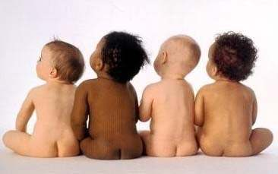
GROWTH AND DEVELOPMENT
Objectives
Define the following terms
Growth
Development
Maturation
learnig
State the stages of development and their respective ages
Explain the principles of growth and development
Discuss four theories of growth and development
Sigmund freud- psychosexual development
Erick Erikson-psychosocial development
Piaget- cognitive development
Kohlberg- moral development

Slide 30
Growth and development.
Growth: -increase in structure – the physical changes in the anatomy of the child.
implies a change in quantity
Increase in number and size of cells thus increasing the size and weight of the whole or any of the parts
It is qualitative in nature
Development: – increase in function
Changes occur in the physiological aspect of the child and they accompany growth
Development also involves the changing from a lower to a more advanced stage of complexity
Development is achieved through growth, maturation and learning
It is qualitative in nature

Slide 31
Maturation: is the process of the unfolding of the genetic or inherited tendencies within the child
Some children are “late” matures while others are “rapid” matures
All children mature at their own rate
It is described as an increase in competence and adaptability
There is a “qualitative” change
Learning: is a “change of behavior”
It is the result of experience, experimentation, and training
The ability to learn is dependent upon the inborn capacity for mental development
NOTE: Maturation and Learning are interrelated. No learning can take place unless the child is mature enough to understand and the behavior is changed. The learning process can be hindered if the child is not given the opportunity learning by experience and from others when the time is optimum.

Slide 32
Stages of development and their respective age ranges
Childhood develoment is devided into stages as follows;
Prenatal; conception to birth
Infancy: birth to 12 – 18 months
neonatal; birth to 27 – 28 days
infancy: 1 – 12 months of age
Early childhood: 1 – 6 years
toddler 1 – 3 years
Preschool: 3 – 6 years
School Age: 6 – 12 years
Adolescent: 13 – 18 years

Slide 33
Developmental Phases
Period | Age
Prenatal period | Conception to birth
Neonatal | Birth to 28days
Infancy period | 1 month to approximately 12 months
Toddler | 1 year to 3 years
Early childhood period | 1year to 6 years
Preschool | 3 years to 6 years.
Middle childhood | 6 to 11 years
Late childhood | 11 to 19 years

Slide 34
Principles of G & D
1. The cephalo-caudal principle- gradual change in head size relative to body size during human growth.
2. Proxi-distal principle-The spinal cord develops before the outer parts
3. Development depends on maturation and learning
4. Development proceeds from the simple (concrete) to the more complex
5. Growth and development is a continuous process
6. Growth and development proceed from the general to specific
7. There are individual rates of growth and development

Slide 35
Basic principles of growth and development.
Growth and development occur in an orderly sequence.
The sequence of development is the same for all children but the rate is different
Children creep before they stand and stand before they walk
talk before they read and read before they write
Each stage of development is an outgrowth of the previous stage
Growth and development continue from conception to maturity.
Differences in growth and development rates.
All children are on their own schedules and are unique to themselves
Variation of Growth Rates for Different Body Structures
Not all body parts mature at the same rate
The brain is completely grown by age 7 but is not matured until years later
Growth and Development is a Total Process
The growth and development of a child is a PHYSICAL, MENTAL SOCIAL and EMOTIONAL process
The development of a “whole being”

Slide 36

Patterns of Growth and Development
Cephalocaudal Pattern (head to toe)
Proximodistal Pattern (from center outward)

Slide 37
Periods of greatest growth
A rapid pace during the foetal period-supply with the essentials through its mother’s placenta.
A rapid pace from birth to 2 years-provided the child’s health is maintained and the essential requirements are given.

Slide 38
Periods of greatest growth
A slower pace from 2 years to puberty and the process is prolonged.
The child’s height gradually increases under the influence of hormones.
This also plays a part in the psychosocial development of the child.
When the child reaches puberty, the sex hormones facilitate the individual’s physical, psychological and emotional development.

Slide 39
Periods of greatest growth
A rapid pace from puberty to approximately 15 years
A sharp decline from 16 years to approximately 24 years when full adult size is reached

Slide 40
Factors that Influence Growth and Development
Genetics
Environment
Culture
Nutrition
Health status
Family
Parental attitudes
Child-rearing philosophies

Slide 41
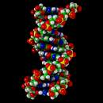
Genetic influences on growth and development
pattern, rate, rhythm and extent:
governed by genes interplaying with environment
intrauterine life extremely important in growth and healthy development of the child

Slide 42
Environmental influences
family composition
family position in society
family socioeconomic status
knowledge of the family
availability of healthy diets
housing
diseases present in family and child

Slide 43
Cultural influences
Must be considered when assessing growth and development
Customs vs. work demands from different cultures

Slide 44
Nutritional influences
Begins during the prenatal period
LBW/preterm can result from poor prenatal nutrition
Socio-economics may impact growth

Slide 45
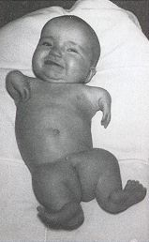
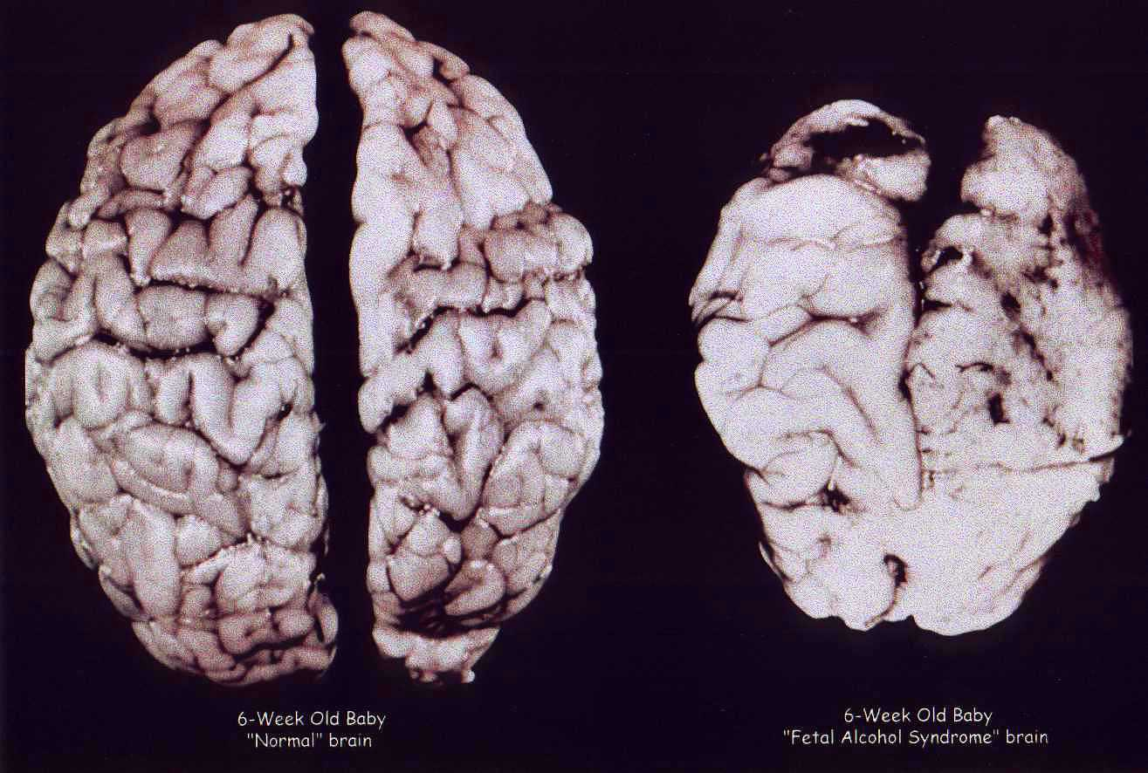
Fetal alcohol syndrome
thalidomide

Slide 46
Health status of the child
Certain diseases may affect g & d
Endocrine and cardiac status included here

Slide 47
Family / Parental Attitudes / Child-rearing Philosophy
Critical in growth and development, esp. emotional growth
Intellectual growth must be included here as well
Chronic illness can be combated with a loving environment and close family relationships

Slide 48
Methods to Evaluate Growth
charts: compare to norms
compare to self over time
X-rays
teeth
height, weight, head circumference
size of head and legs: length of bones

Slide 49
Developmental Theories Growth and Development

Slide 50
What is a Theory
Organized and logical set of statements about a subject, frameworks to clarify, to make sense of.
Human Development Theory: Models intended to account for how and why people become who they are, tries to explain and predict human behavior.

Slide 51
Why study theory?
Provides a framework
Offers logic for observations and explanations
How and why people act
Important for nurses to combine theory, practice, and research
Nurses assess responses to illness and treatments

Slide 52
Theorists Associated with Development
Jean Piaget: Periods of cognitive development
Erik Erikson: Stages of psychosocial development
Lawrence Kohlberg: Stages of moral development
Sigmud Freud: Stages of psychosexual development

Slide 53

Freud’s Psychosexual Stages of development

Slide 54
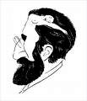
Freud’s Psychosexual Stages
Oral Stage: Birth to 18 Months
Anal Stage: 18 months to three years
Phallic stage: 3 years to 7-8 years
Latency Stage: 7-8 years to puberty
Genital Stage- Puberty to Adulthood

Slide 55
Piaget’s Theory of Cognitive Development
Jean Piaget (1896–1980) Swiss psychologist who became leading theorist in 1930s
Piaget believed that “children are active thinkers, constantly trying to construct more advanced understandings of the world”
Cognitive development is a stage process

Slide 56
Piaget’s Approach
Primary method was to ask children to solve problems and to question them about the reasoning behind their solutions
Discovered that children think in radically different ways than adults
Proposed that development occurs as a series of ‘stages’ differing in how the world is understood

Slide 57
Piaget
Preoperational Stage (2–7 years) | Emergence of symbolic thought Egocentrism Lack of the concept of conservation Animism
Concrete Operational (7–12 years) | Increasingly logical thought Classification and categorization Less egocentric Conservation No abstract or hypothetical reason
Formal Operational Stage (age 12 – adulthood) | Hypothetico-deductive reasoning Emerges gradually Continues to develop into adulthood

Slide 58
Intellectual Development (Piaget)
Concrete Operational (7 to 11)
Logical & coherent thought
Can distinguish fact from fantasy
Formal Operations (11 to 15 to adulthood)
Acquisition of abstract reasoning leading to
Analytical thinking
Problem solving
Planning for the future

Slide 59
Create a Mnemonic for Piaget’s Four Stages
Examples:
Sometimes Piaget Can Frustrate!

Slide 60
Rules for Toddlers
If I like it, it’s mine.
If it’s in my hand, it’s mine.
If I can take it from you, it’s mine.
If I had it a little while ago, it’s mine.
If it’s mine, it must never appear to be yours in any way.

Slide 61
Rules for Toddlers, continued
If I’m doing or building something, all the pieces are mine.
If it looks like mine, it’s mine.
If I saw it first, it’s mine.
If you are playing with something, and you put it down, it automatically becomes mine.
If it’s broken,
it’s yours!

Slide 62
Promote Psychosocial Development (Erikson)
Trust vs. Mistrust: (birth to 1 year)
Establishes a sense of trust when basic needs are
Nurses should provide consistent, loving care
Autonomy vs. Shame & Doubt: (1-3 yrs)
Increasingly independent in many
spheres of life
Nurses should allow for self care & imitation

Slide 63
Initiative vs. Guilt: (3-6 yrs)
Learns to initiate play activities.
Nurses should encourage to explore environment with senses, promote imagination
Industry vs. Inferiority: (6-12 yrs)
Learns self worth as a workers & producers
Allow children to compete and cooperate

Slide 64
Psychosocial Development (Erikson)
Identity vs. Role Confusion: (12-18 yrs)
Forms identity and establishment of autonomy from parents
Peers, society big influence
Encourage peer visitation, texting, phone calls

Slide 65
Erikson’s Theory
Stage | Age | Psychosexual | Psychosocial Crisis | Virtue | Danger
Infancy | to age 2 | Oral/ Sensory | Trust vs. Mistrust | Hope | Withdrawal
Early | 2-3 | Muscular/ Anal | Autonomy vs. Shame | Will | Compulsion/
Play Age | 3-5 | Locomotor/ | Initiative vs. Guilt | Purpose | Inhibition
School Age | 6-12 | Latency | Industry vs. Inferiority | Competence | Inertia
Adolescence | 12-18 | Puberty | Identity vs. Identity Confusion | Fidelity | Role Repudiation
Young | 19-35 |  | Intimacy vs. Isolation | Love | Exclusivity
Adulthood | 35-65 |  | Generativity vs.Stagnation | Care | Rejectivity
Old Age | after 65 |  | Integrity vs. Despair | Wisdom | Disdain

Slide 66
Kohlberg’s Theory of Moral Development
Assessed moral reasoning by posing hypothetical moral dilemmas and examining the reasoning behind people’s answers
Proposed six stages, each taking into account a broader portion of the social world

Slide 67
Levels of Moral Reasoning
Preconventional—moral reasoning is based on external rewards and punishments
Conventional—laws and rules are upheld simply because they are laws and rules
Postconventional—reasoning based on personal moral standards

Slide 68
Kohlberg’s Levels of Moral Development
Preconventional
Conventional
Postconventional
Moral reasoning is controlled by external rewards and punishments.
Internal standards are imposed by others.
Morality is internal, not based on external standards.

Slide 69
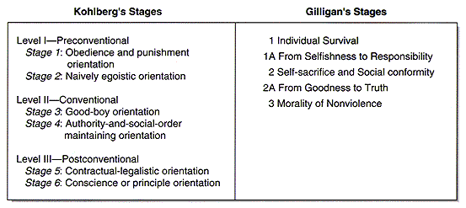
Moral Development

Slide 70
Lawrence Kohlberg Moral Development Theory
Level 1- Preconventional
Stage 1- Punish and Obey
Stage 2- Instrumental Relativist
Level 2- Conventional
Stage 3- Good boy/Nice girl
Stage 4- Society Maintenance
Level 3- Post-Conventional
Stage 5-Social Contract
Stage 6- Universal Ethics

Slide 71
Stages of Moral Development Lawrence Kohlberg
Level | Stage | Ages | Social Orientation
Pre-Conventional | 1 | 2-4 | Obedience and Punishment
 | 2 | 4-7 | Individualism, Instrumentalism
Conventional | 3 | 7-10 | Good Boy/Girl
 | 4 | 10-12 | Law and Order
Post-Conventional | 5 | Teens | Social Contract
 | 6 | Adult | Principled Conscience

Slide 72

Let’s Practice! Situation 1
Ashley borrowed her father’s car. She and her friend Kayla were very late coming home that evening. They were further delayed at a stop light on a quiet street. After what seemed to be an unnecessary long wait, Kayla reminded Ashley that they were late. Ashley continued to wait, insisting that if everyone ignored stop lights when it was personally convenient to do so, no street would be safe.
At what stage do you think Ashley’s decision was? Why?

Slide 73

Situation 2
Jordan was not prepared for a difficult chem. Exam, so he wrote some important formulas on a slip of paper which he put in his pocket before the test. Just before the test began, the teacher informed the class that any student caught cheating would automatically fail the test. Even though Jordan needed the information he wrote, he didn’t use it because the teacher stood too close to his desk during the entire exam.
At what stage? Why?

Slide 74

Situation 3
Early in the school year, DeShawn who started at varsity basketball, asked Caitlin for a date. Caitlin was not attracted to DeShawn and politely declined. A few weeks later Caitlin tried out for cheerleading and made it. Several of the other cheerleaders were dating boys on the team. When DeShawn asked Caitlin to go with him to a party that the team was having after an important game, she accepted.
At what stage? Why?

Slide 75

Situation 4
Kyle asked his older sister, Gabby, if he could borrow her car so that he and his friend could go to the beach. Gabby reminded her brother that she never wanted him to drive her car. She suggested, however, that if it was all right with him, they could all go together. Soon after they got to the beach, Kyle’s friend got ill. Kyle asked Gabby if she could drive his friend home. Gabby refused, saying that she had just come all that way and she was not going to turn around and go right back. Kyle tried unsuccessfully to find a way to get his friend home. Finally, while Gabby was swimming, he wrote her a note telling her he would be back soon as possible, took her car keys, and drove his friend back home.
What stage? Why?

Slide 76
Situation 5
As Jason’s father was leaving for work in the morning, he asked Jason to clean out the garage sometime during the day. Jason responded, saying he already had plans to play tennis that day. Around noon, Jason and two friends made plans that required Jason to borrow his father’s car that evening. Jason decided to skip playing tennis and clean the garage.
What stage? Why?

Slide 77
Kohlberg’s Theory of Moral Development Theory into Practice
Sam starts to get out of his seat to sharpen his pencil without permission. He stops because he realizes that if he does, others might also do so and this could result in disorder in the classroom. Because of this, he understands that it is his duty to follow the rules.
Q: At which of Kohlberg’s stages of moral development is Sam functioning?
Notes:
A: Stage 4: Social Systems Morality. He is obeying the rule because he understands the importance of rules to maintaining order.

Slide 78
Kohlberg’s Theory of Moral Development Theory into Practice
Sam starts to get out of his seat to sharpen his pencil without permission. He stops because he realizes that if he does, he will be punished.
Q: At which of Kohlberg’s stages of moral development is Sam functioning? Explain.
Notes:
A: Stage 1: Heteronomous morality. He is obeying the rule out of fear of punishment.

Slide 79
Kohlberg’s Theory of Moral Development Theory into Practice
Sam starts to get out of his seat to sharpen his pencil without permission. He stops because he realizes that if he does, it will displease his teacher.
Q: At which of Kohlberg’s stages of moral development is Sam functioning? Explain.
Notes:
A: Stage 3: Mutual Interpersonal Expectations, Relationships, and Interpersonal Conformity. He is obeying the rule to preserve a relationship.

Slide 80
Intellectual Development (Piaget)
Sensorimotor (birth to 2)
learns from movement and sensory input.
learns cause & effect
Preoperational (2 to 7)
Increasing curiosity and explorative behavior.
Thinking is concrete
Egocentrism

Slide 81
Developmental Milestones
Age in months | Milestones
2 | Attention to objects
3 | No head lag when pulled up to sitting position
5 | Reaches out for object
6 | Asymmetric tonic neck reflex disappeared, sits steadily
10 | Bears weight on leg when standing, chews lumpy foods.
18 | Walks independently, has stopped casting or mouthing objects
20 | Says single words with meaning
28 | Puts two or three words together to make phrases
36 | Talks in sentences

Slide 82
Developmental Milestones
Developmental warning signs | Age
Not smiling at mother | 8 Weeks
Poor head control | 6 Months
Unable to sit unsupported | 9 Months
Not crawling | 12 Months
Unable to stand with help | 12 Months
Not babbling | 12 Months
Unable to stand unaided | 15 Months
Not walking independently | 18 Months
Unable to understand simple commands | 2 Years
Not using two to three words. | 2.5 Years

Slide 83
DEVELOPMENTAL CHARACTERISTICS
1. Physical maturation: overall Gross and fine motor growth, mobility and erectness
2. Cognitive development: learning, awareness, perception and memory- use of senses
5.Psychosocial development: relational through play and interaction with people and the environment
6. Mental development: communication and language, social behavior, self care, intelligence and learning

Slide 84
Normal developmental milestones
6 weeks:
Movt and posture
Head lag not quite complete
Primitive responses persist
Vision and manipulation
looks at a toy held in midline
follows a moving person
Hearing and speech
vocalizes with gurgles
Social behavior
smiles briefly when talked to by mother

Slide 85
4 months
Movt and posture:
Holds head up in sitting position
Rolls from prone to supine
Primitive responses are gone
Vision and manipulation
Watches hands
Pull at their clothes
Tries to grasp objects
Hearing and speech
Turns head to sound laughs
Social behaviour: recognizes mother, becomes excited by toys

Slide 86
7 months+
Movt and posture: sits unsupported,rolls from supine to prone,bounces with pleasure,
Vision and manipulation: transfers objects from hand to hand,bangs toy on table, watches small moving objects
Hearing and speech: says da,ba,ka,
Social behavior: tries to feed himself, puts objects in their mouth

Slide 87
10 months
movt and posture; crawls, gets to sitting position without help,can pull up to standing,lifts one foot when standing,
Vision and manipulation:reaches for objects with index finger,has developed finger-thumb grasp,will place objects on examiner’s hands but not release them,
Hearing and speech;says one word with meaning
Social behavior;say bye-bye,deliberately drops objects,puts objects in and out of boxes

Slide 88
13 months
Movt and posture;walks unsupported,may shffle on buttocks and hands
Vision and manipulation:can hold two cubes in one hand,makes marks with pen,
Hearing and speech:says two or three words with meaning
Social behavior:understands simple questions

Slide 89
15 months
Movt and posture;stands without support,climbs stairs,walks with broad based gait
Vision and manipulation:builds a tower of two cubes,takes off shoes
Hearing and speech;around 12 words
Social behavior:asks for things by pointing,can use a book

Slide 90
18 months
Movt and posture;runsand jumps,can climb onto a chair and sit down
Vision and manipulation;tower of three cubes,turns pages of a book,scribbles
Hearing and speech;is beginning to join two words together
Social behavior:recognizes cars and animals in a book,points to nose,ear on request,carries out simple orders,

Slide 91
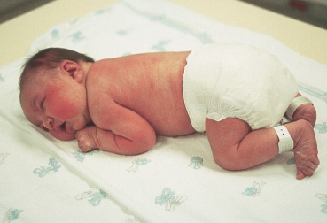
Newborn Flexion

Slide 92
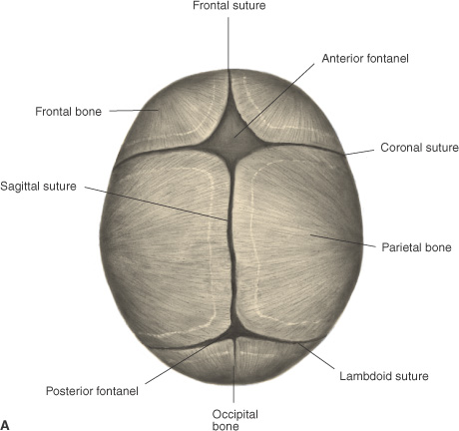
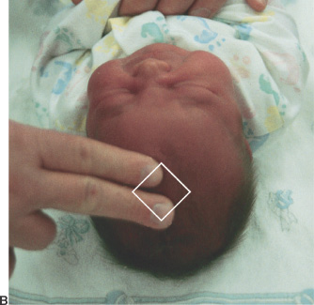
Fontanels

Slide 93
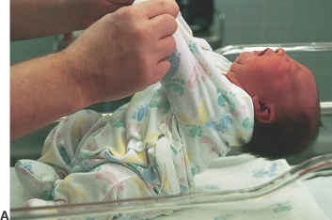
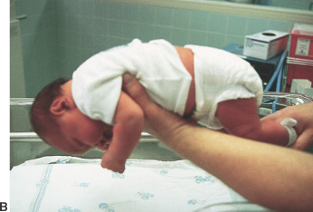
Newborn Head Control

Slide 94
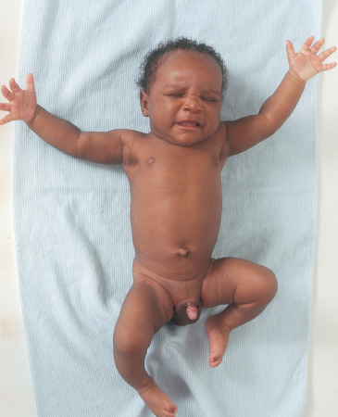
Moro Reflex

Slide 95
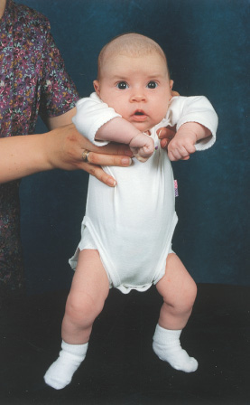
Dance/step/walking reflex

Slide 96
Care of hospitalized child
“Atraumatic Care”
Use of interventions that eliminate or minimize psychological and physical distress that is experienced by children and their families in the health care system

Slide 97
Promotion of normal development
Infants: oral-motor development
Toddlers: encourage mobility & exploration, language development
Preschoolers: assistance with self-care
School-aged: socialization, provision of games & tasks for mastery
Adolescents: increased independence in managing own care

Slide 98
Stressors of Hospitalization
Separation Anxiety
Loss of Control
Bodily Injury & Pain

Slide 99
1. Separation Anxiety (Universal fear of toddler)
Protest: loud, demanding cries, rejects comfort measures
Despair: lies on abdomen, flat facial expression, weight loss, insomnia, loss of developmental skills
Denial or Detachment: silent expressionless child, deterioration of developmental milestones, may have trouble forming close relationships

Slide 100
Nursing Diagnosis
Anxiety r/t separation from parents during hospitalization.
Goal: child will exhibit minimal evidence of separation anxiety during hospitalization.
Outcome criteria: observe child’s positive interactions with staff members & adherence to hospital routine, appropriate for age & stage of development.

Slide 101
Nursing Interventions
Limit admissions
Limit hospital stay
Reduce pain
Adequately prepare child for procedures
Open visiting (include siblings)
Primary nursing
Use of play
Hospital bed = “safe area”
Increase control

Slide 102
2. Loss of Control
Children loose control over their:
Routine
Body
Basic decisions
Loss of school, boredom
Ability to socialize

Slide 103
Interventions
Infants: Provide consistent care
Toddlers: maintain consistent routine
Toddlers often have security objects such as a stuffed animal that help them feel safe and secure
Preschoolers: need adequate preparation to unfamiliar experiences, fear bodily injury
School-aged: provide schoolwork, social
Adolescents: same as schoolage, privacy

Slide 104
Interventions: Play!
Provides diversion, brings about relaxation.
Helps child feel more secure in strange environment.
Helps lessen stress of separation.
Means for release of tension & fears.
Means for accomplishing therapeutic goals.
Allows making choices & being in control.

Slide 105
3. Bodily Injury
Procedures are uncomfortable
Disease processes are painful
Postoperative pain can be very severe

Slide 106
Assess for Pain
Infants: watch facial expression, FLACC
Toddlers: grimace, clench teeth, restless
Preschoolers: can locate pain, use face scale, fear bodily injury & mutilation, literal
School-aged: fear disability & death, pain is punishment, “magical quality” of germs, can use faces scale
Adolescents: use same pain scale as adults

Slide 107
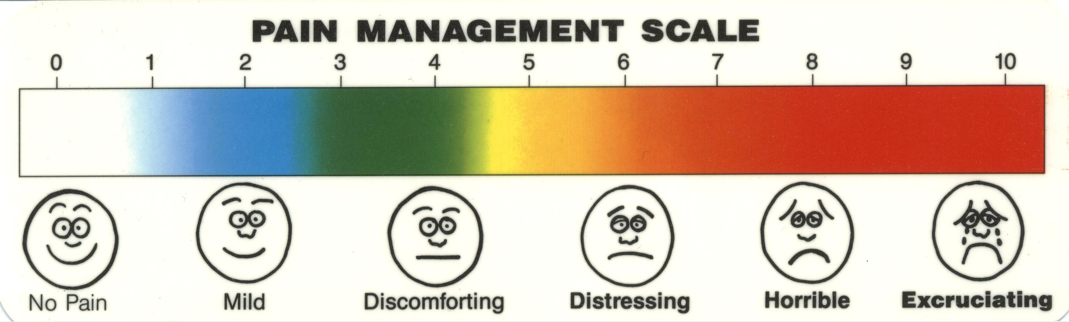
Pediatric Pain Assessment
Pain is whatever the child experiencing it says it is”.

Slide 108
Children are under-medicated because of these MYTHS:
infants don’t feel pain
children tolerate pain better than adults
children cannot tell you where it hurts
children always tell the truth about pain
children become accustomed to painful procedures
parents do not want to be involved in child’s pain control
narcotics are more dangerous for children

Slide 109
Interventions
Nurses have an ethical obligation to relieve a child’s suffering
In addition adequate pain relief leads to
earlier mobilization
shortened hospital stays
reduced costs.

Slide 110
Assess the child using QUESTT:
Question the child.
Use pain rating scales.
Evaluate behavior & physiologic changes.
Secure the parents’ involvement
Take into consideration: cause of pain.
Take action & evaluate results.

Slide 111
Interventions
Medicate for Pain
Non Pharmacological Therapy
Cutaneous Stimulation
Distraction
Guided Imagery
Hot or Cold application
Relaxation

Slide 112
Hospitalization for all pediatric patients
GOALS:
Child will be prepared.
Child will experience little or no separation.
Child will maintain sense of control.
Child will exhibit decreased fear of bodily injury.

Slide 113
ETAT
At the end of the unit you will be able to:
Triage all sick children when they arrive at a health facility, into the following categories:
those with emergency signs
those with priority signs
those who are non-urgent cases.
Assess a child’s airway and breathing and give emergency treatments.
Assess the child’s status of circulation and level of consciousness.
Manage shock, coma, and convulsions in a child.
Assess and manage severe dehydration in a child with diarrhoea.
Plan and implement ETAT in your own working area in your hospital.

Slide 114
Many deaths in hospital occur within 24 hours of admission.
Some of these deaths can be prevented if very sick children are quickly identified on their arrival and treatment is started without delay.
In many hospitals around the world, children are not checked before a senior health worker examines them; as a result, some seriously ill patients have to wait a very long time before they are seen and treated.
Children are known to have died of a treatable condition when waiting in the queue for their turn.
The idea of triage is to prevent this from happening.

Slide 115
Triaging of Sick Children
Is the process of sorting of patients into priority groups according to their needs and the resources available.
It involves rapidly examining all sick children when they first arrive in hospital in order to place them in one of the following categories:
Those with EMERGENCY SIGNS who require immediate emergency treatment.
Those with PRIORITY SIGNS should be given priority in the queue.
Those who have no emergency or priority signs and therefore are NON-URGENT cases can wait their turn in the queue

Slide 116
The triaging process
Triaging should not take much time. For a child who does not have emergency signs, it takes on average 20 seconds.
The health worker should learn to assess several signs at the same time.
FOR EXAMPLE
A child who is smiling or crying does not have severe respiratory distress, shock or coma. The health worker looks at the child, observes the chest for breathing and priority signs such as severe malnutrition and listens to abnormal sounds such as stridor or grunting.

Slide 117
METHODS OF TRIAGING
Several methods are available to facilitate the triaging process.
One example is a stamp being used in Malawi consisting of the “ABCD” signs in which the health worker circles the correct step and initiates emergency treatment “E” or puts them in priority groups “P” or “Q” for children who can wait in the queue.
Colours can also be used for differentiating the three groups, giving a red sticker to emergency cases, a yellow for priority and green for the queue.

Slide 118
Who should be triaged ?
When and where should triaging take place?
Who should triage?

Slide 119
EMERGENCY SIGNS
Those with EMERGENCY SIGNS who require immediate emergency treatment.
If you find any emergency signs, do the following immediately:
Start to give appropriate emergency treatment.
Call a senior health worker and other health workers to help.
Carry out emergency laboratory investigations.

Slide 120
Those with PRIORITY SIGNS
They should be given priority in the queue, so that they can rapidly be assessed and treated without delay.
Those who have no emergency or priority signs and therefore are NON-URGENT cases.
These children can wait their turn in the queue for assessment and treatment.

Slide 121
Re-view
Categories after triage | Action required
EMERGENCY CASES | Need immediate emergency treatment
PRIORITY CASES | Need assessment and rapid attention
NON-URGENT CASES | Can wait their turn in the queue

Slide 122
Emergency Signs
Triage of patients involves looking for signs of serious illness or injury.
Children with these signs require very urgent life support procedures.
Relate to the ‘ABCD’
Airway
Breathing
Circulation/Consciousness/Convulsion/Coma
Dehydration
During care of children with such signs
Always assess for any danger in the environment to self and to patient
Call for help
Weigh if possible
If there is history of trauma, ensure cervical spine is protected

Slide 123
Airway
Check for airway obstruction
Management
Look, listen, feel.
If obstructed by foreign bodies, secretions or head position perform head manouvers(Neutral position for neonates,Jaw thrust or head-tilt chin-lift for older children) to open the airway, suck all secretions.
An airway (oropharyngeal tube) can be inserted if available
If foreign body remove it, or perform backslaps or Heimlich manouver to expel them
Re-assess after every intervention

Slide 124
Breathing
Check for
Central cyanosis
Severe respiratory distress
Weak or absent breathing
Management
Look, listen, feel for breathing
If not breathing, give 5 rescue breaths; each breath should last 2-3 seconds. Check rise in chest with each breath given
Re-assess
Support breathing with oxygen via right-sized and well fitting face mask (or if indicated and with mechanical ventilator)

Slide 125
Circulation
Check for:
Capillary refill of more than 3 seconds
Weak, rapid thready pulse
Absent or Slow heart rate of less than 60beats/min
Management
If pulse is slow (<60bpm for infants and neonates), weak or absent and breathing is absent perform cardiopulmonary resuscitation (CPR) 15 chest compressions: 2 breaths
Reassess at regular intervals
If no change after CPR
Give I.V Adrenaline 0.1ml/Kg body weight of 1:10 000 adrenaline concentration
Continue CPR for 3 mins. Reassess
Repeat adrenaline a 2nd dose if necessary

Slide 126
If pulse is > 60bpm, continue breathing support with oxygen,
look for sign of dehydration or poor circulation and give emergency I.V fluid (1st Bolus of 20mls/Kg body weight of Ringer’s lactate or Normal saline)
Consider treating for hypoglycemia, continue full examination to consider cause of illness
When to Stop CPR
If no gasping or breathing after 20 minutes of CPR or gasping but no breathing after 30 minutes
Decision to stop resuscitation depends on local resources

Slide 127
Convulsions
Management
I.V diazepam 0.3mg/Kg body weight or rectal 0.5mg/Kg body weight
Reassess
Repeat diazepam if still convulsing
Reassess
If still convulsing, give I.M phenobarbital 20mg/Kg body weight(Neonates) or 15mg/Kg body weight for infants and young children

Slide 128
Consciousness/Coma
Assess for level of consciousness using AVPU scale
A – Alert
V – responds to Voice
P – responds to Pain
U – Unconscious/Unresponsive – This is a child in coma
A child who is not alert but responds to voice is lethargic

Slide 129
Dehydration results due to diarrhoea
Check if the child:
Is lethargic or unconscious
Has sunken eyes
Skin pinch goes back very slowly
Management is by IV fluid therapy as described at ‘Circulation’
When ABCD has been completed and there are no emergency signs, continue to assess the PRIORITY SIGNS.

Slide 130
PRIORITY SIGNS
Priority signs should alert you to a child who needs prompt, but not emergency assessment.
Children with these should be front of the queue.
Clinical review as soon as possible, Weigh, Baseline observations
Use the acronym 3TPR MOB
Tiny - Sick infant aged < 2 months
If the child appears very young, ask the mother his age
Temperature – very high > 39.50C
A child that feels very hot may have high fever. Children with high fever on touch need prompt treatment
Trauma – major trauma or other major surgical condition
Includes even the invisibles: acute abdomen, fractures and head injuries

Slide 131
Pain – child in severe pain
may be due to severe conditions such as acute abdomen, meningitis, etc.
Poisoning – mother reports poisoning
A child with a history of swallowing drugs or other dangerous substances needs to be assessed immediately, as he can deteriorate rapidly and might need specific treatments depending on the substance taken
Pallor – severe palmar pallor
Is a sign of severe anaemia which might need urgent transfusion

Slide 132
Restless / Irritable / Floppy
Lethargic child i.e. Child who is at V in the AVPU scale
Respiratory distress
e.g. lower chest wall indrawing (not severe), or difficulty in breathing
NB: Severe respiratory distress is an emergency sign
Referral – has an urgent referral letter
Read the note carefully and determine if the child has an urgent problem.
Malnutrition - Visible severe wasting; a sign of marasmus
To assess for this sign, look rapidly at the arms and legs as well as the child’s chest.
Oedema of both feet
is an important diagnostic feature of kwashiorkor, another form of severe malnutrition
Burns – severe burns
Burns are extremely painful and children who seem quite well can deteriorate rapidly

